Slide 1
Computer shortcut keys

Slide 2
Computer shortcut keys:-
Computer shortcut keys are combinations of keyboard keys that perform specific tasks or actions more quickly than using a mouse. These shortcuts help improve productivity and streamline workflows. Below is a list of some common shortcut keys for both Windows and MS OFFICE

Slide 3
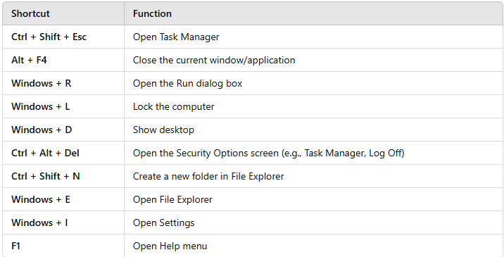
BASIC SHORTCUT KEYS:

Slide 4
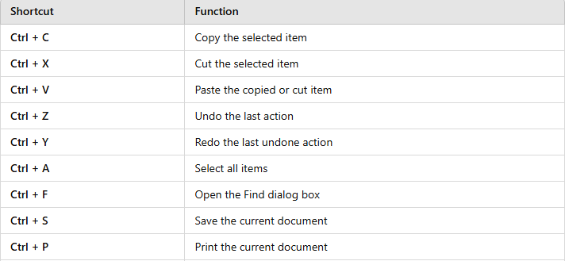
Windows Shortcuts KEYS

Slide 5
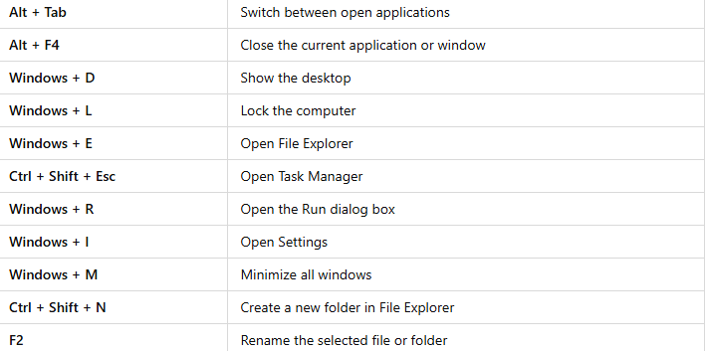

Slide 6
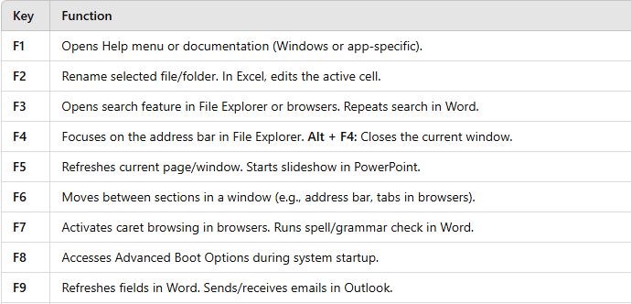
function key f1 to f12

Slide 7
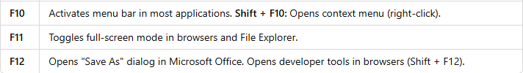

Slide 8
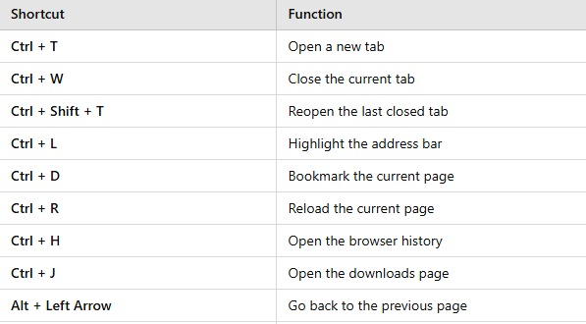
Browser Shortcuts

Slide 9
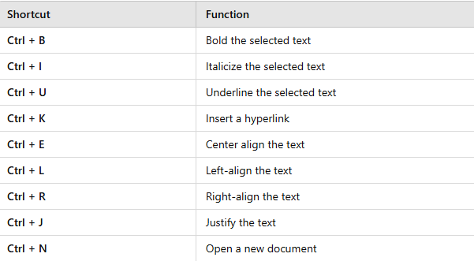
Microsoft Word Shortcuts KEYS

Slide 10
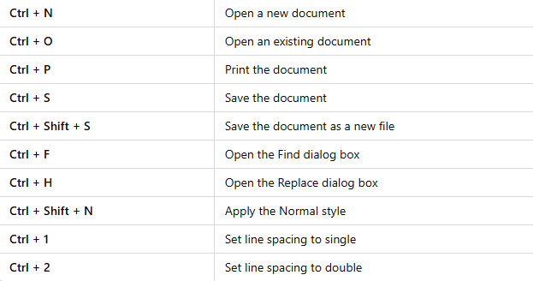

Slide 11
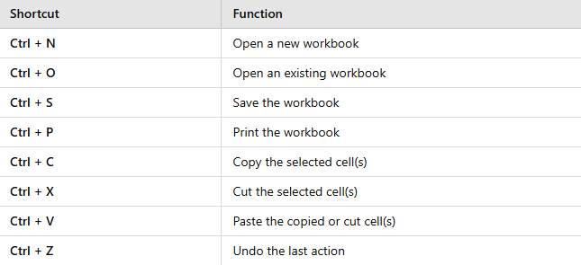
Excel Shortcuts KEYS

Slide 12
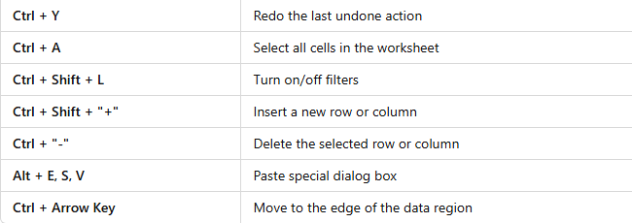

Slide 13
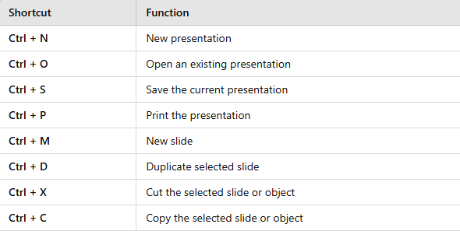
PowerPoint Shortcut Keys

Slide 14
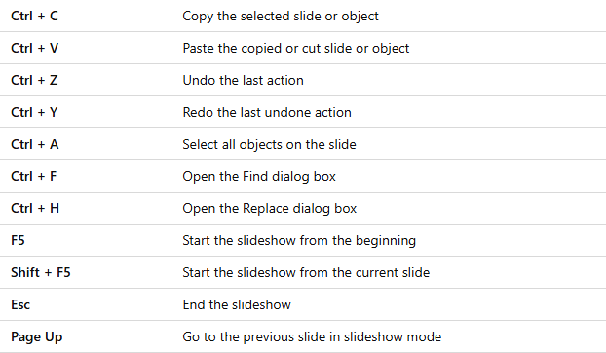

Slide 15
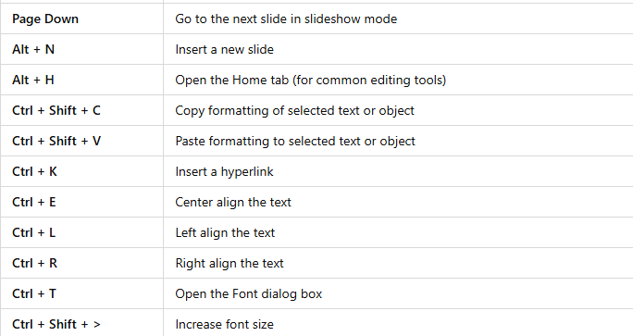

Slide 16
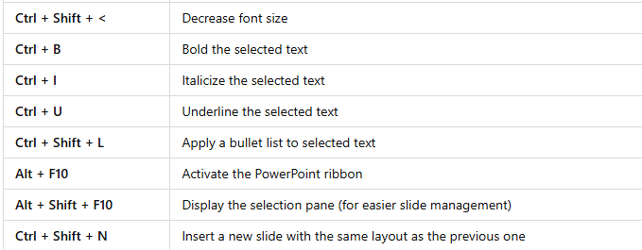

Slide 17
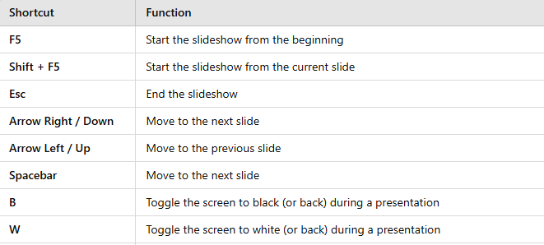
Slide Show Mode Shortcuts KEYS

Slide 18
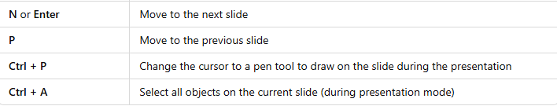

Slide 19
THANK YOU

